Slide 1
Simple Programming Concepts

Slide 2
Some basics
What is a programming language?
A formal language designed to communicate instructions to a machine
What is an IDE?
Usually a software program that enables you to develop, debug and test software programs that you write – by giving you a friendly environment with helper tools
Different types of languages/environments
Language history
Structured/object oriented/functional/dynamic
Compile and execute?

Slide 3
Java Setup
Javac.exe = the compiler
Bytecode/ .class files
Java.exe = the executor
Java installation
Why java at all?
IDE using java
Command line – show example if time allows

Slide 4
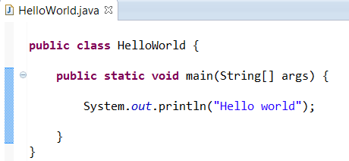
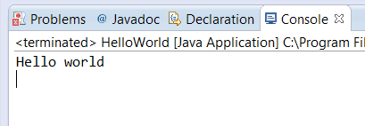
HelloWorld.java

Slide 5
HelloWorld.java notes
The concept of a class
Main method
Braces
Printing to the console
Concept of a console application
Naming
Semi-colon

Slide 6
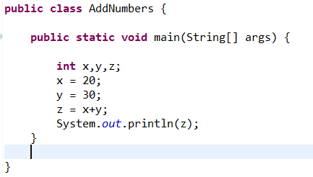
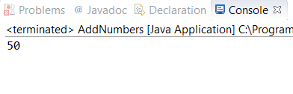
AddNumbers.java

Slide 7
AddNumbers.java notes
Variables
Enable the storage of data in memory
Variable Declarations
Variable Assignment
Printing out variable values

Slide 8
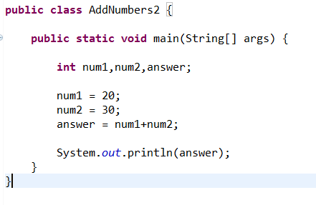
AddNumbers2.java
Naming variables correctly

Slide 9
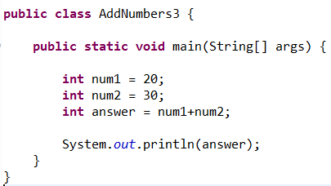
AddNumbers3.java notes
Variable declaration and assignment in single line

Slide 10
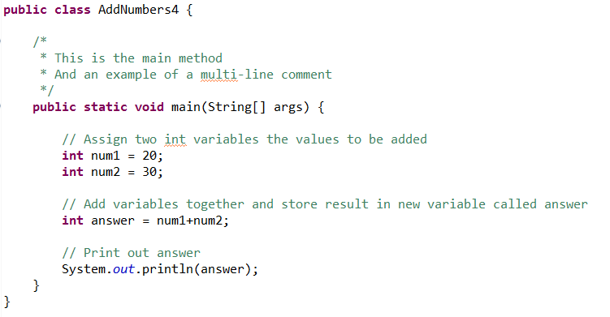
AddNumbers4.java
Utilising comments (single line and multiline)

Slide 11
VariableTypes.java
Different variable types
Operations on variables
Incrementing/decrementing
Order of operation precedence
Brackets get executed first
Division/Modulo
String concatenation
Getting string length
Relational operators and equality

Slide 12
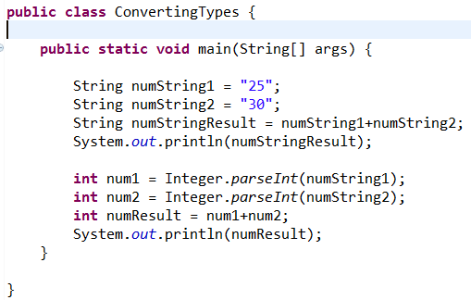
ConvertingTypes.java
Demonstrate converting from String to int
Very useful – knowing conversions

Slide 13
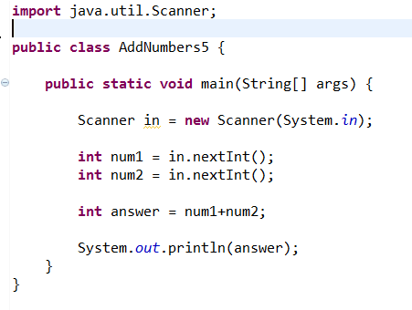
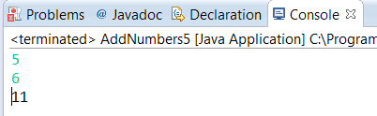
AddNumbers5.java
Use of Scanner
Use of import
Not that informative

Slide 14
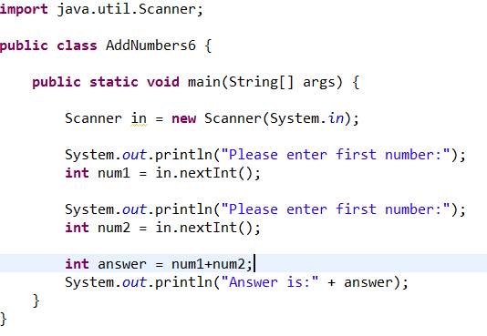
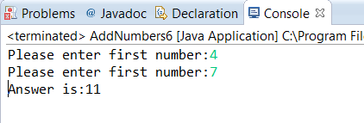
AddNumbers6.java
Use of print instead of println
Informative

